Slide 1


Toothpaste

Slide 2

Book

Slide 3

Notebook

Slide 4

Pencil

Slide 5

Scissors

Slide 6

Toy

Slide 7
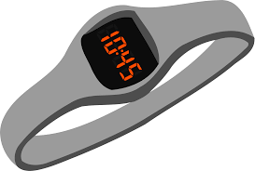
Watch

Slide 8

Doll

Slide 9
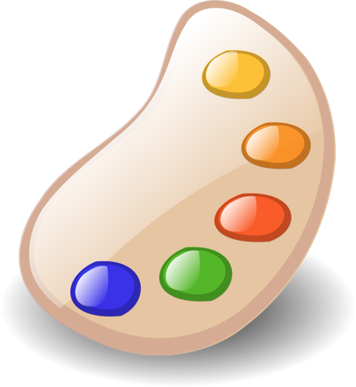
Colors

Slide 10

Paintbrush
ম
জা
রু

